Slide 1


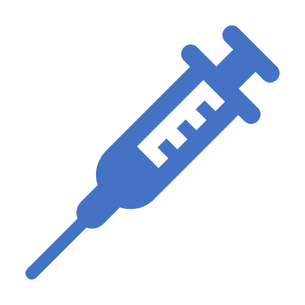







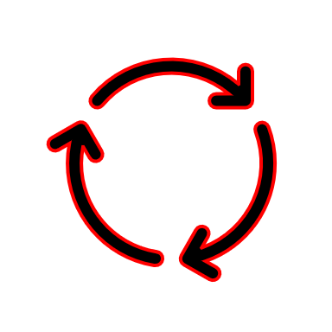





ZeroRabiesApp: Ensuring equitable access to lifesaving treatment Aniruddha Belsare, PhD Assistant Professor of Disease Ecology abelsare@auburn.edu

Slide 2
The burden of canine rabies
50,000 humans die every year due to dog-transmitted rabies.
At least 20,000 human deaths every year in India due to rabies.
India has the highest burden of rabies.
2/10
Notes:
In the year 2021, 5 Americans died of rabies. One of the victims was bitten by a rabid dog while traveling in the Philippines and died after returning to the US. The other 4 were bitten by bats and died because of ignorance - they either didn't realize that bat bites can transmit rabies or refused post-bite vaccination. Five people dying of rabies in a year is the largest number in a decade for the US.

Slide 3
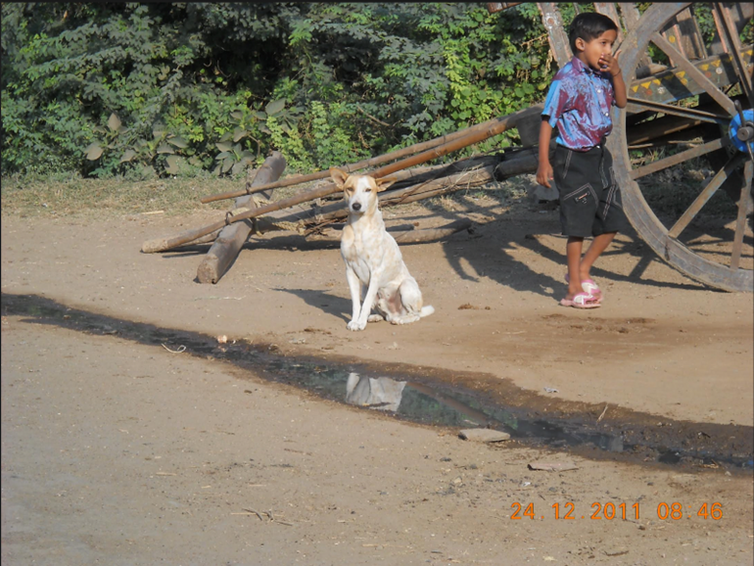
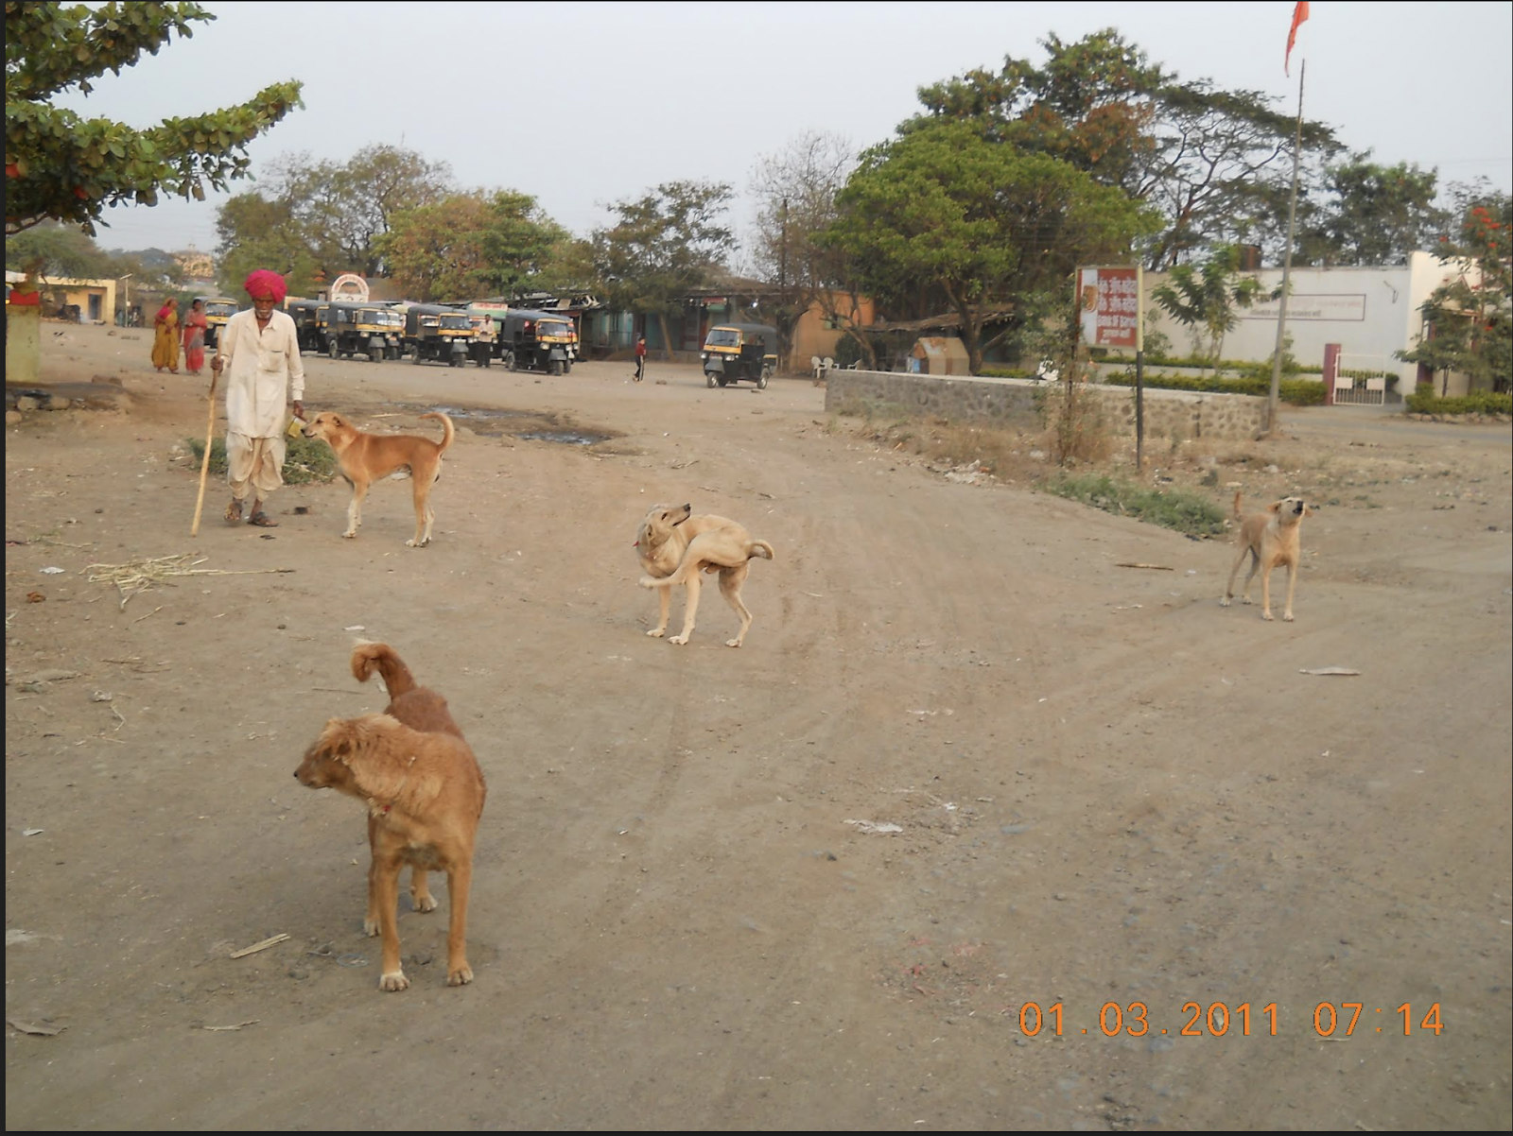
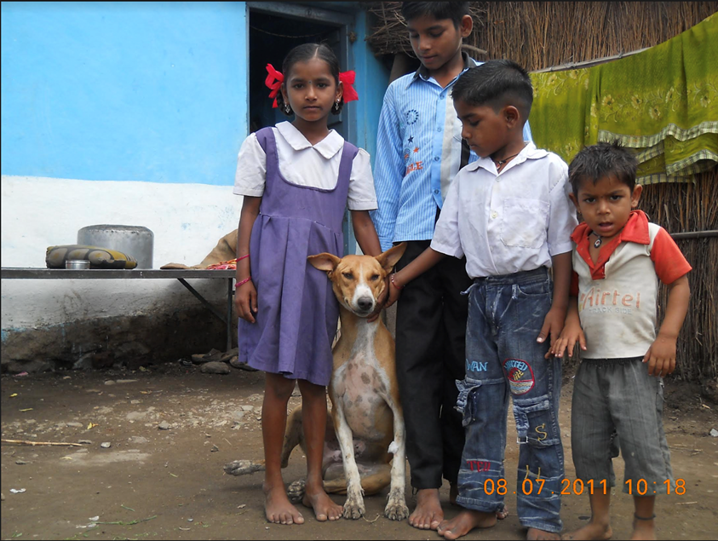
DOG-TRANSMITTED RABIES IS A neglected disease
3/10
Notes:
More than 90% of the rabies deaths occur in remote rural areas and it affects the poor disproportionately.

Slide 4
Rabies: 100% fatal, but 100% preventable
Three vital components of postbite treatment:
Bite wound management
Course of Antirabies vaccines (RV)
Injecting Human rabies immune globulin (RIG)
Timely administration of appropriate postexposure prophylaxis (PEP)
is critical to prevent rabies
4/10
Notes:
- Timely administration of appropriate postexposure prophylaxis (PEP) after a dog bite is critical to prevent rabies
-Awareness
- Ignorance on the part of healthcare professionals
- Availability: shortages of vaccines and rig

Slide 5
TIMING OF POSTBITE TREATMENT
Wound management: Simple, but timing is of utmost importance
Emergency response to a rabies exposure; 4 doses of rabies
vaccine; 1 st dose within 24 hours of exposure (e.g. dog bite)
Rabies Immune Globulin within 7 days of exposure (e.g. dog bite)
5/10
Notes:
Cost of PEP: US$108

Slide 6
RABIES VACCINE AND RIG availability
70-80 million free-roaming dogs in India
20 million dog bites every year
Shortage of rabies vaccines and RIG: resulting in delay/ incomplete treatment or even non-administration
PEP products not readily available across India and often in short supply.
6/10
Notes:
not readily available and often in short supply in the developing world, especially in Asia and Africa where rabies is endemic in domestic dog populations and poorly controlled
Dog bite victims or their caretakers, often from remote rural areas, typically must go on an expedition to find PEP, resulting in delays or even non-administration.
Rabies prevention and control in India has so far been unsuccessful mainly due to poor knowledge of proper PEP and irregular availability of rabies biologics

Slide 7
FAILURE OF RABIES CONTROL IN INDIA
Ideal rabies prevention and control has so far been unsuccessful in India mainly due to
poor knowledge of proper PEP, and
an irregular availability of rabies biologics
7/10
Notes:
not readily available and often in short supply in the developing world, especially in Asia and Africa where rabies is endemic in domestic dog populations and poorly controlled
Dog bite victims or their caretakers, often from remote rural areas, typically must go on an expedition to find PEP, resulting in delays or even non-administration.
Rabies prevention and control in India has so far been unsuccessful mainly due to poor knowledge of proper PEP and irregular availability of rabies biologics

Slide 8
Web application: ZERO RABIES APP
Interactive point-of-care tool for treating dog bite cases
For both dog-bite patients and their health providers
Access to latest guidelines developed by the World Health Organization (WHO) and the Centers for Disease Control and Prevention (CDC).
8/10
Notes:
To help address these challenges, we developed an online web application, ZeroRabiesApp (ZRA), using the shiny package in R software. The ZRA is designed as an interactive point-of-care tool for treating dog bite cases, providing access to latest guidelines developed by the World Health Organization (WHO) and the Centers for Disease Control and Prevention (CDC).
The ZRA also provides access to the rabies biologics database that can be used to find nearest locations where PEP products are currently available.

Slide 9
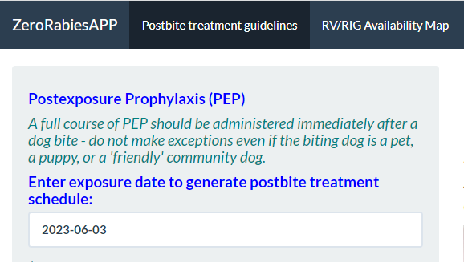
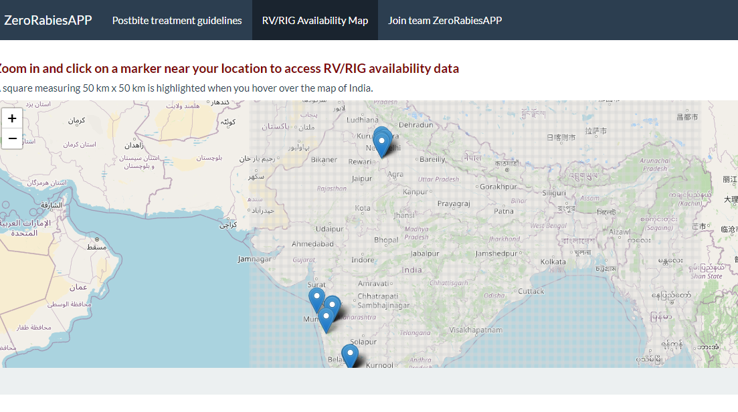
PERSONALIZED PEP SCHEDULE & AVAILABILITY DATABASE
9/10

Slide 10
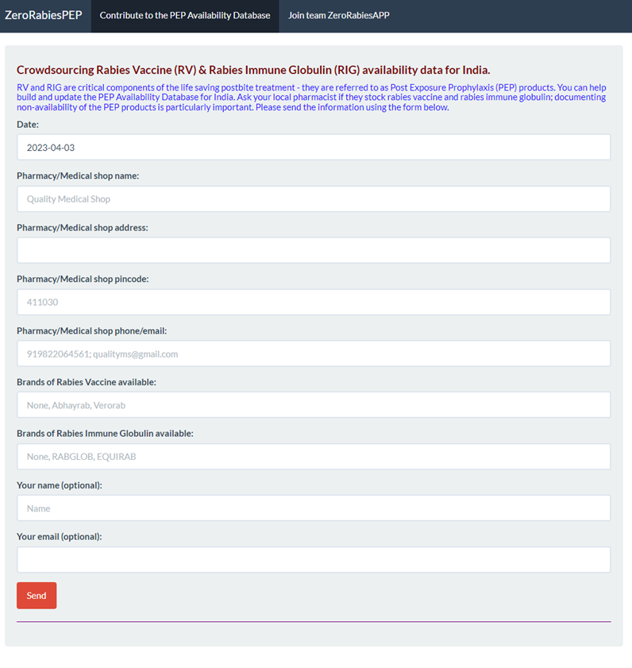
PILOT PROJECT: CROWDSOURCING PEP AVAILABILITY
ZeroRabiesApp
https://anyadoc.shinyapps.io/ZeroRabiesINDIA/
ZeroRabiesPEP
https://anyadoc.shinyapps.io/ZeroRabiesPEP/
10/10
Notes:
Leveraging pharmaceutical supply chains
to build and update a database of facilities (pharmacies/medical shops/clinics/hospitals) in India where such products are currently available
We will study the pharmaceutical supply chain in Pune District (~ 6000 square miles, and the most populous district in the state of Maharashtra) to better understand the distribution process of PEP products. We will work with regional associations (e.g., Pune Chemists’ Association, Maharashtra State Medical Representative Association, Indian Medical Association, etc.) to improve and promote the accessibility of ZRA and ZRP.

